Slide 1
Work from everywhere
We design a code hosting platform for version control and collaboration, letting team members work together on projects from anywhere.
This report is to demonstrate how this platform works and maintained.

Slide 2
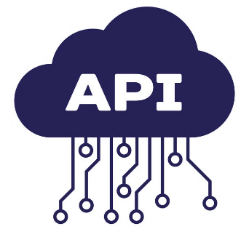

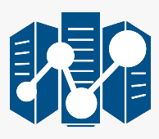

Workflow
3
Stage 1: Data Extraction
Data are extracted through the newly written module “request_phs” and stored in the team member’s local server who collected it from the data sources. This person will then commit and push this data to the shared GitHub platform. With the approval from the team leader, this data will incorporate in the cloud database.
Stage 2: Modeling
At the end of the day, every team member should commit their codes and send a pull request to the GitHub platform to get their work reviewed. In case of approval, their work will merge into the main branch of the developing sub-project. If declined, it should be re-written and the submit/ review process restarted.
Stage 3: Handover
When the sub-project gets approvals from the Committee. The resulted models will regularly run by the Data Analytics Team and their outputs will be post to an Application Program Interface (API) through the module named “post_phs”, this API is the environtment where Data Analytics Team and IT department interact without the need of a common propramming language. IT department can send a get-request to this API and pull all model’s results back to their local computers and incorporate those result to the company’s system.
post_phs
request_phs
Stock Exchange
IT Department
commit/push mechanism
request_phs
Bloomberg Terminal
GitHub Platform
Data Analytics Team
2
request_phs
FiinPro Terminal
1
Data sources

Slide 3
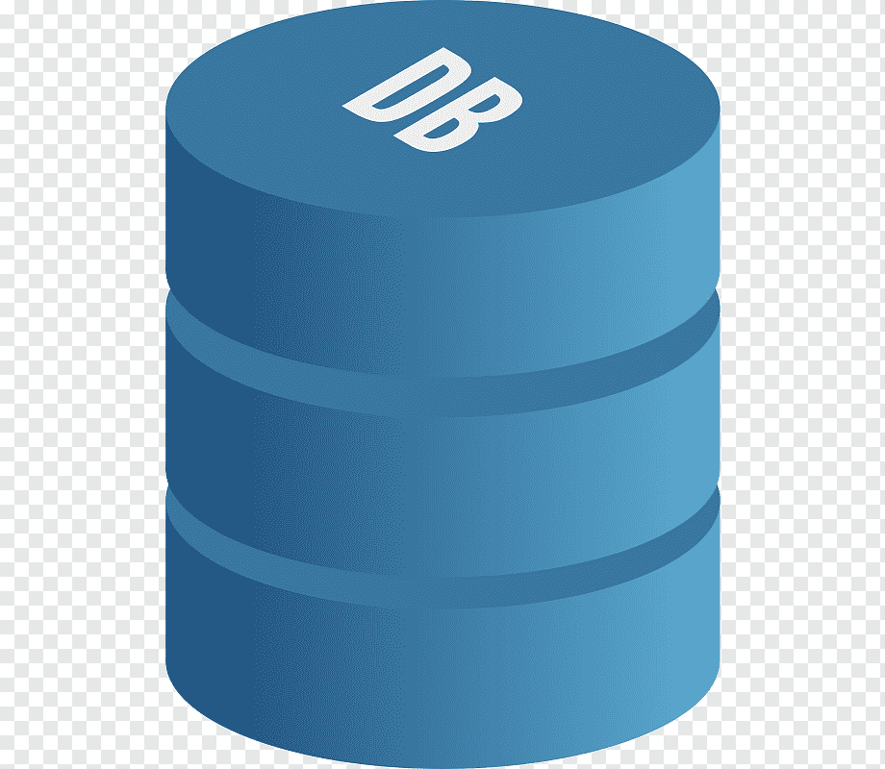
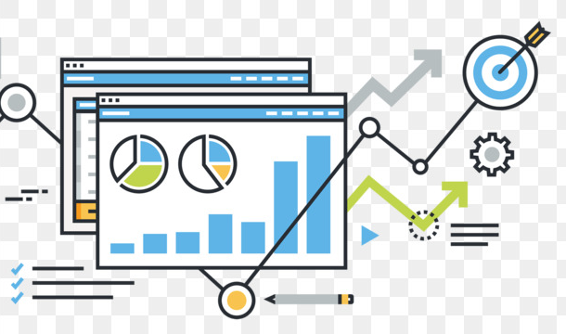
The way our team cooperates with other departments
Data Driven Project
The project is structured to make it stand alone from other parts of the whole process. The only two connections that link this project to other company’s departments are “request_phs” and “post_phs” modules.
breakeven_price
credit_rating
Sub-project 3
Sub-project 4
request_phs
post_phs
(module)
Sub-project 5
(module)
Data sources
Local database
Sub-project 6
Sub-project 7
……
Results merged into the company’s system
IT Department

Slide 4
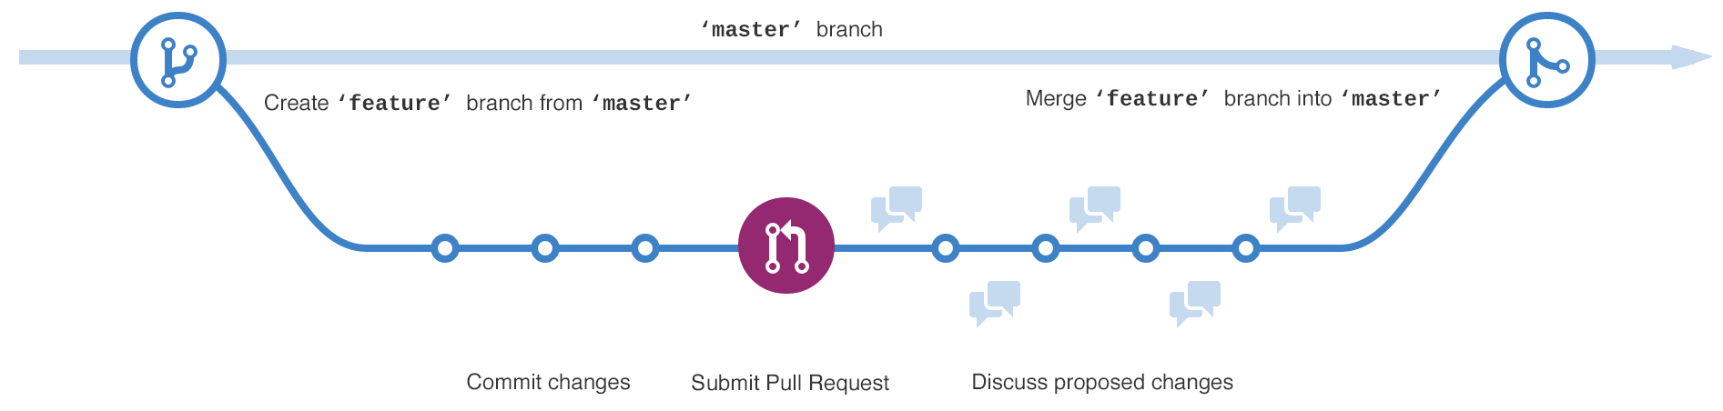
The way our team managed internally
Send feedback and request to re-write declined codes
There is always a single version of project maintained in platform.
At the beginning of the day, each team member should send a request directly to the platform to clone the latest version of project to their local computers.
During the day, they write their code locally as usual.
At the end of the day, they are required to submit their codes by sending a pull request to the platform. The platform will notify the team leader about this submission and display a comparison between the latest version and the newly-written codes.
If the code is approved by the team leader, it will be incorprate to platform and becomes the latest version. If it’s declined, it will be sent back the submittor to re-write, and the submit/review process restarts.
Team Member
Team Member
Send pull request to get the codes reviewed
Push approved codes to the main project
Receive and review all pull requests
GitHub Platform
Team Leader
Team Member
Team Member

Slide 5
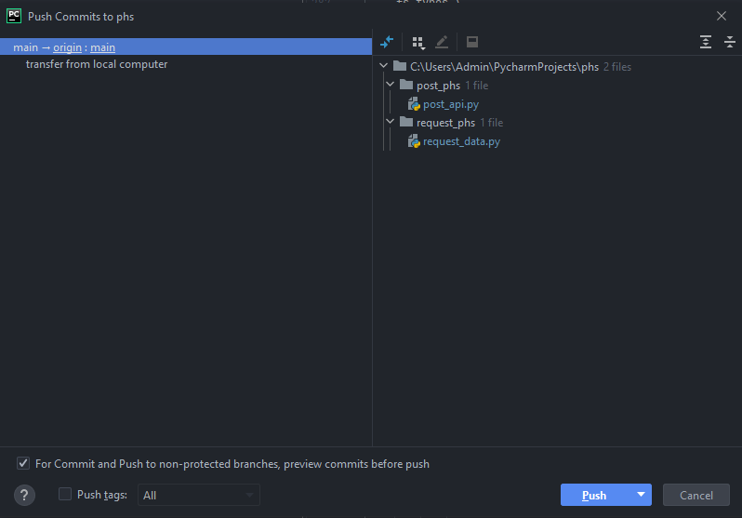
What’s inside the platform
Pull, commit, push, compare buttons, respectively
After hitting the commit and push buttons, this is the interface showed to the team members. They are required to check all files they have changed, make comment to briefly describe what they have done.

Slide 6
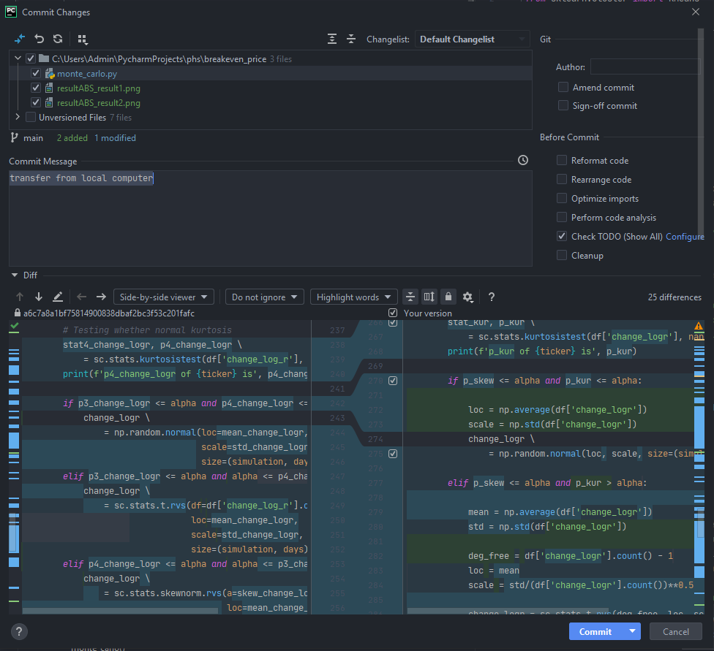
What’s inside the platform
This is the interface displayed to the team leader to review newly-written code from other team members. Every lines of code that are changed or added are highlighted and compared to the latest version in the main project.

Slide 7
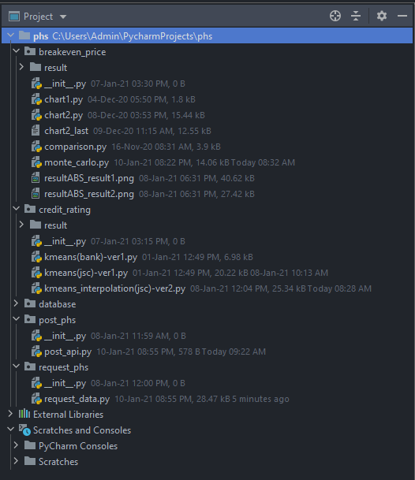
What’s inside the platform
Every team members are granted the access to view the structure tree of the entire project

